Slide 1
Decentralized E-voting System Using Blockchain Technology
Project III (PROJCS801)
In partial fulfilment of the Degree of
Bachelor of Technology
In
Department of CSE(IOTCSBT)
Submitted by:
Faizan Shakeel (22021002017005)
Under the Guidance of
Prof. Dr. Soumadip Biswas
Institute of Engineering and Management, Kolkata 2024

Slide 2
Content of the Presentation
Topic | Slide No:
Introduction | 3-4
Problem Statement | 5
Proposed Work | 6
Requirements | 7
Control Flow | 8
Result and Analysis | 9-11
Comparison with Existing Works | 12
Conclusion and Future Works | 13
References | 14

Slide 3
Introduction
What is Blockchain ?
A blockchain is a decentralized and distributed ledger System.
Anyone from anywhere, over the internet connection, can use blockchain system.
A blockchain is an online decentralized database which is transparent and tamper-proof.
Bitcoin, Ethereum, Ripple, Solana etc are Blockchain Networks.

Slide 4
Why Blockchain Based Voting System ?
Transparency: Ensures a transparent and auditable voting process..
Security: Enhances security through cryptographic techniques.
Decentralization: Eliminates the central authority.
Trust: Builds trust by providing an immutable record of votes.
Accessibility: Enables convenient remote voting from anywhere with internet access.

Slide 5
Problem Statement
Problem Statement:
Centralized voting systems are vulnerable to hacking, fraud, and tampering with election results.
Lack of transparency only Authorised person can see the data.
Operation Cost are high in Traditional Voting System.
Objective:
The election system must be openly verifiable and transparent.
It must ensure that the vote casted by voter has been recorded.
Only Eligible voters must be allowed to vote.
The election system should be temper-proof.

Slide 6
Proposed Work
Enhanced Security:
Proposed Work: Utilize blockchain technology for secure and tamper-proof voting records.
Existing System: Relies on centralized databases prone to hacking and tampering.
Transparency and Auditability:
Proposed Work: Implement a transparent ledger system for real-time auditing of votes.
Existing System: Offers limited transparency in the vote-counting process.
Accessibility :
Proposed Work: Enable remote voting options to increase voter participation.
Existing System: It requires physical presence at polling stations, limiting accessibility for certain demographics.

Slide 7
Requirements
Software Specification: | Operating System : Windows, Mac, Android Backend: Solidity Other Requirements: Remix IDE, Metamask wallet, Blockchain Explorer, Testnet Ethereum
Hardware Specification: | Processor: Intel i3 or above RAM: 4GB Hard Disk:16 GB

Slide 8
Data Flow/ Control Flow
Candidate Name
Candidate Age
Add Candidate
Candidate ID
Admin
Admin Page
Add Voter
Voter’s Web3 Wallet
Address
Application
Connect Wallet
Start/Stop Voting
Yes
Cast Vote
User
User Page
Eligibility Check
No
Can’t Cast Vote
Voting Status
Live Result
Winner

Slide 9
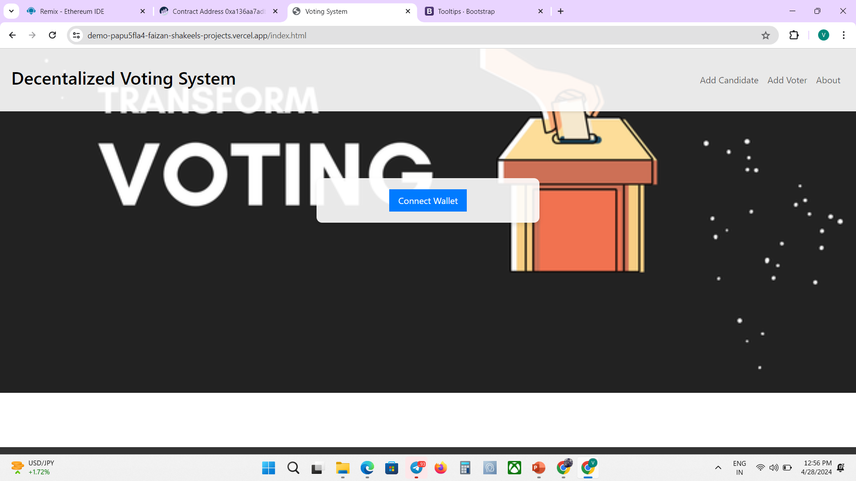
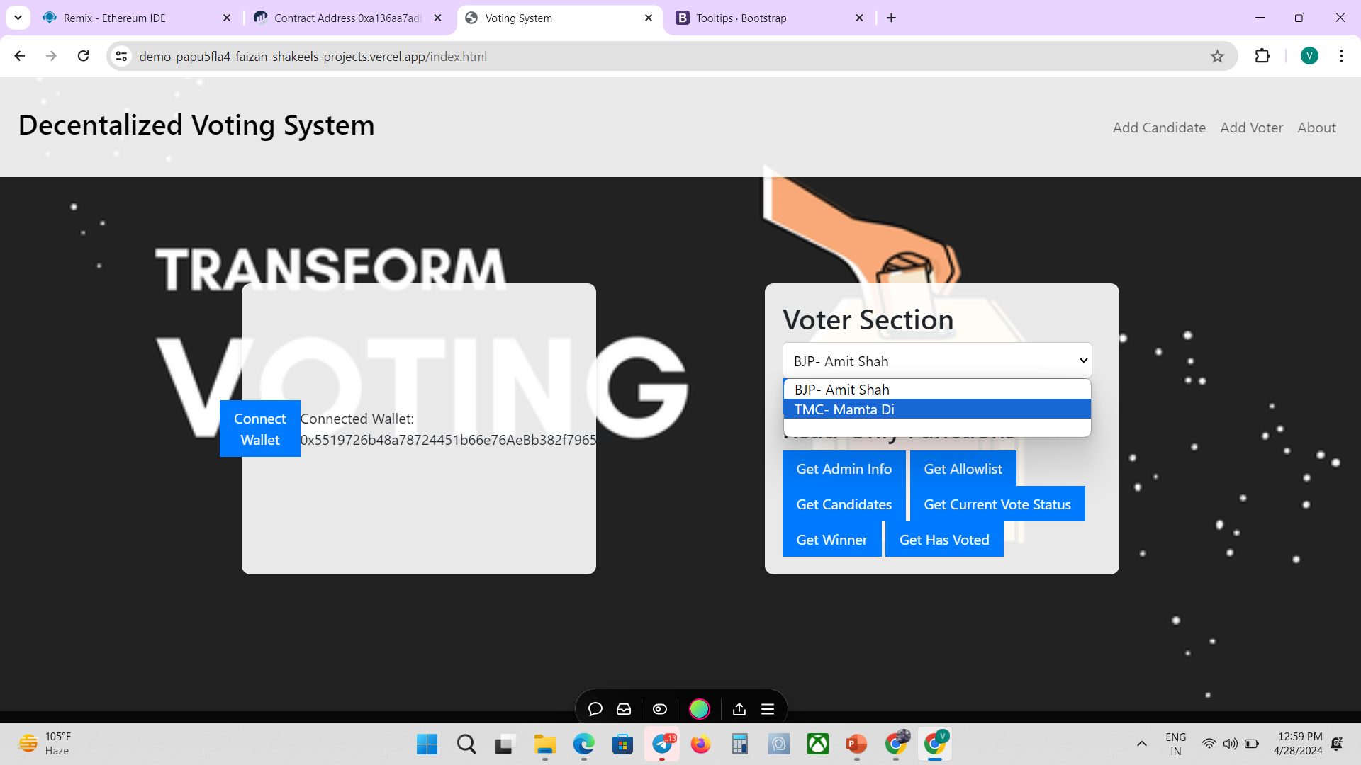
Result and Analysis
Snapshot 1: Landing Page
Snapshot 2: Voter Page

Slide 10
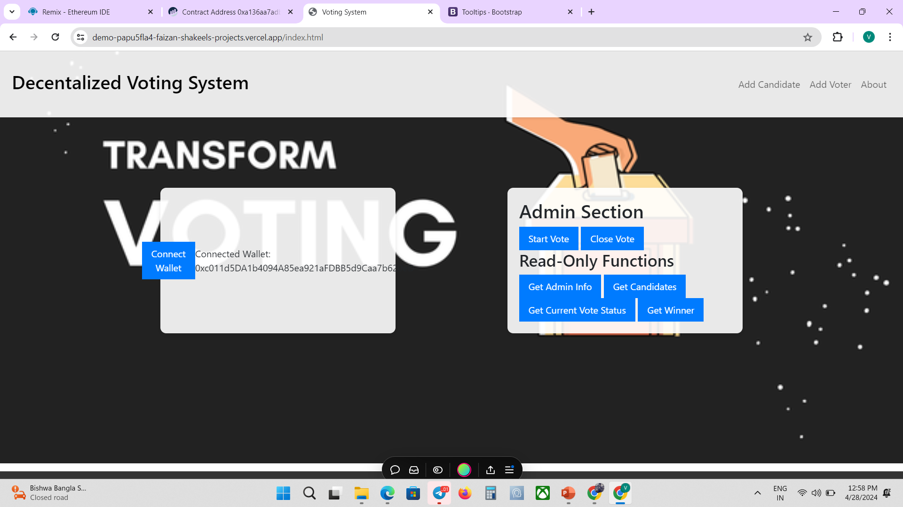
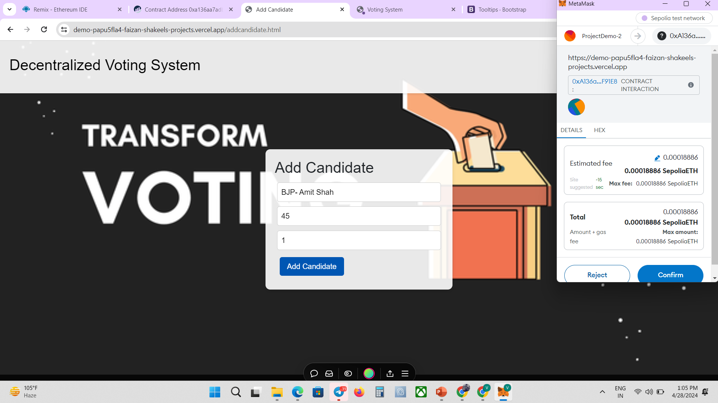
MetaMask Authentication Popup
Snapshot 3: Admin Page
Snapshot 4: Add Candidate Page

Slide 11
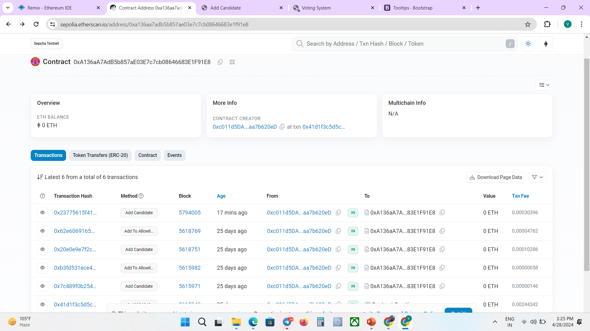
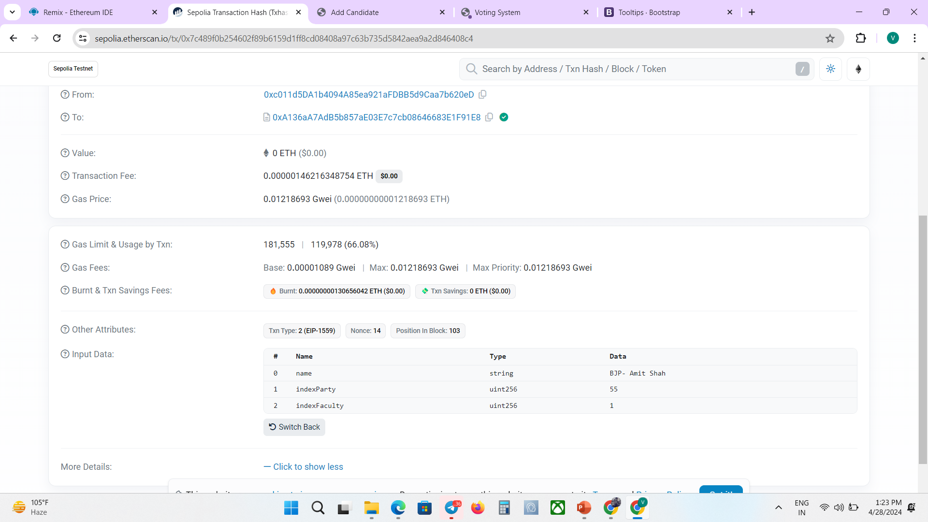
Transaction Hash
Snapshot 5: Transaction Stored On Blockchain Explorer
Candidate Details
Snapshot 6: Candidate Details On Blockchain Explorer

Slide 12
Comparison with Existing Works
 | During Vote | Page landing | Allowlist | Addition during voting | Status
My Work | User can see live Voting results | Automatic redirect separate admin and voter page | User allowlist checker available | Candidate and voter cannot be added when voting is open | User can check their voting status
Linh Vo-Cao-Thuy Votereum: | User Can only vote | Only voting page | No allowlist checker | Candidate and voter cannot be added when voting is open | No option to check user voting status
Faizan Shakeel (22021002017005)

Slide 13
Conclusion and future works
Conclusion:
Implementing a decentralized e-voting system offers significant advantages over traditional centralized voting methods.
By using blockchain technology, we can enhance the security, transparency of the electoral process.
It enhances transparency, security, and auditability through immutable records and cryptographic techniques.
Implementing such a system can strengthen trust in electoral processes and pave the way for a more democratic and secure voting environment.
Future Works:
Additional biometrics (fingerprint, face authentication) can be added to enhance the security of the system.
Distributed Document Storage to store any private and confidential document related to candidate and voter .
Candidate’s earlier social work and qualification’s can be added for a voter to have better choice.

Slide 14
References
Paul Wackerow, August 16, 2022, this documentation is designed to help you build with Ethereum https://ethereum.org/en/developers/docs/
Solidity Documentation. (n.d.). Introduction to Smart Contracts. Retrieved from https://docs.soliditylang.org/en/latest/introduction-to-smartcontracts.html
Ethers.js Documentation. (n.d.). Getting Started. Retrieved from https://docs.ethers.org/v5/getting-started/
Linh Vo-Cao-Thuy, Khoi Cao-Minh, Chuong Dang-Le-Bao and Tuan A. Nguyen, (2019), Votereum: An Ethereum-based E-voting system.
David Khoury, Elie F. Kfoury, Ali Kassem and Hamza Harb, (2018), Decentralized Voting Platform Based on Ethereum Blockchain.

Slide 15
THANK YOU

